Slide 1

Fire-Fighting Robot
Group-9
Nitya Shah 21110191
Arjun Paan 23110041
Github Page

Slide 2
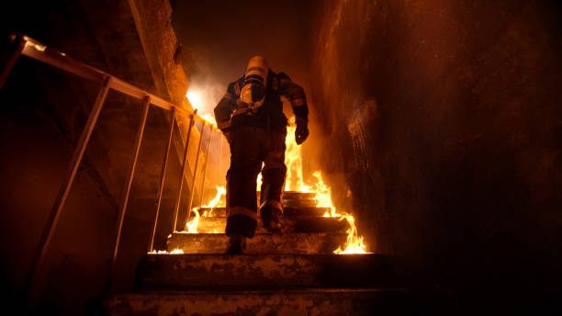

Problem Statement
Firefighters face serious risks from heat, toxic smoke, and dangerous environments, leading to potential burns, long-term health issues, and physical injuries.
Heat
Smoke and Gases
Dangerous Locations
Source:- checkmatefire.com
“why a problem”.

Slide 3
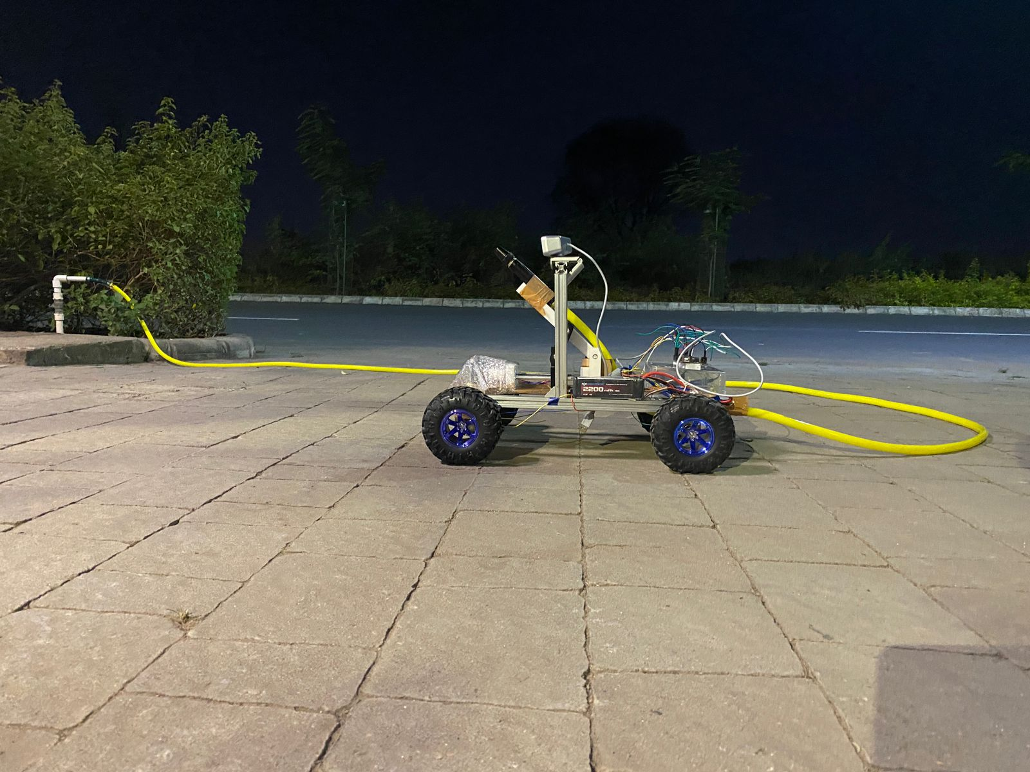
Proposed Solution
Developing the fire fighting robots to enhance the safety of the firefighters.
Notes:
Reach Difficult Areas: Robots can access hard-to-reach locations.
Lower Risk: Reduce the danger to firefighters.
Extended Operation: Robots can work for longer periods.
Efficient Coverage: Handle large areas without human constraints.

Slide 4
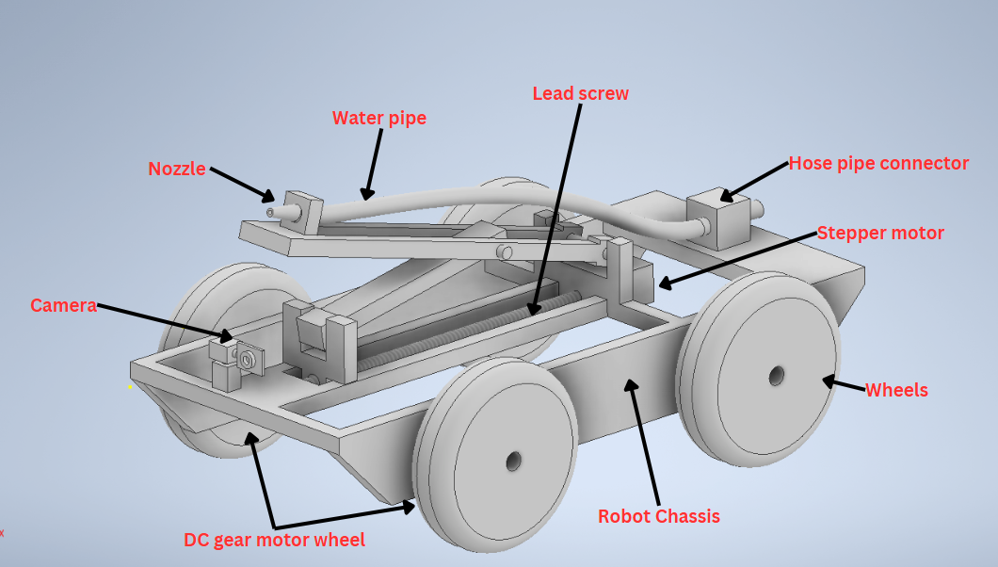
Proposed Design

Slide 5
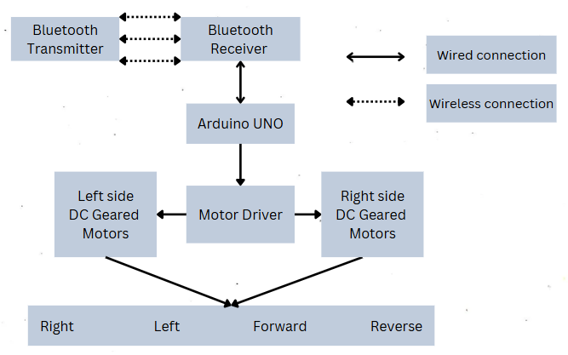
Mechatronic Architecture For Motion Control

Slide 6
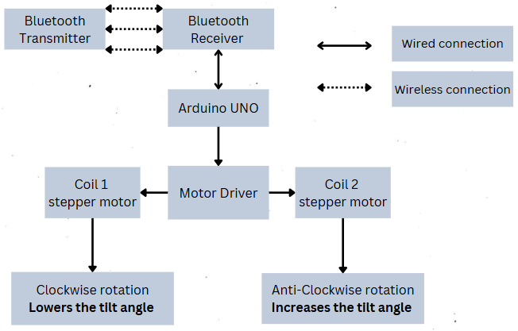
Mechatronic Architecture for Tilt Mechanism Control

Slide 7
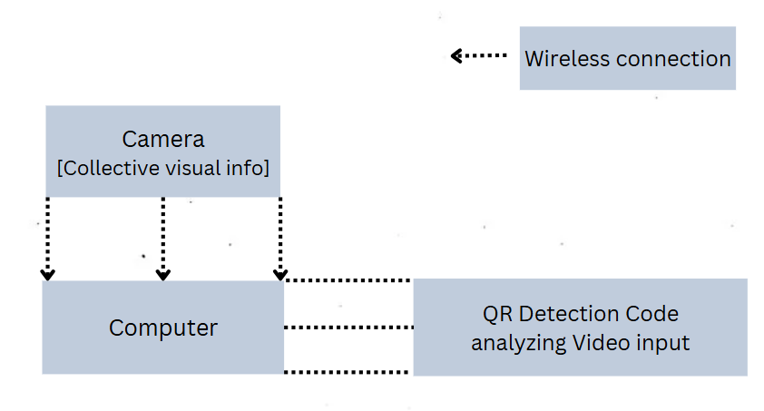
Mechatronic Architecture for QR Detection

Slide 8
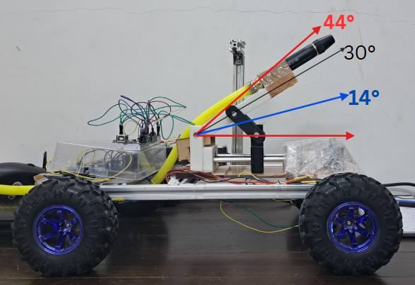
Robot’s Capacity
Avg. Velocity of Robot = 0.4 m/s
Vel. of water from nozzle = 6.4 m/s
@ Water flow rate = 250ml/s
Range of water jet = 1.9 - 4.5 m
Max range @ θ = 44° is 4.2 - 4.3m
Min range @ θ = 14° is 1.9 - 2.2m

Slide 9
Image of Prototype

Slide 10

Video Demonstration
"Fire {QR} Detection & Water Targeting"
"Robot Navigating Compact Spaces for Fire Inspection"
"Extinguishing Large Open Fire"
Video Demonstration

Slide 11
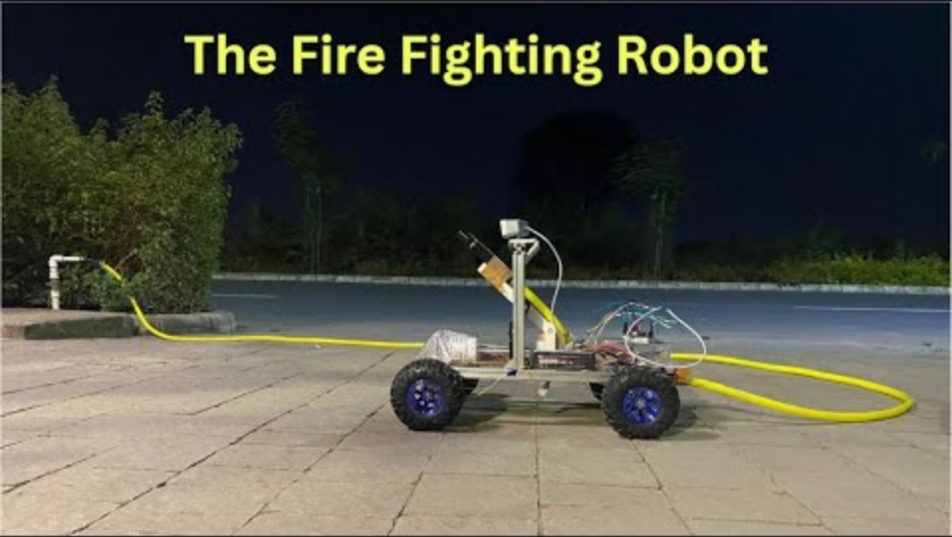

Slide 12
Conclusion and Future Development
This robot offers manual control, enabling fire suppression in tight, hazardous spaces where firefighters can't easily reach.
Aim to make it fully autonomous
Ensuring rapid deployment
Eliminating the need for skilled operators,
Making fire response faster and more efficient.
Notes:
This robot offers manual control, enabling fire suppression in tight, hazardous spaces where firefighters can't easily reach.

Slide 13
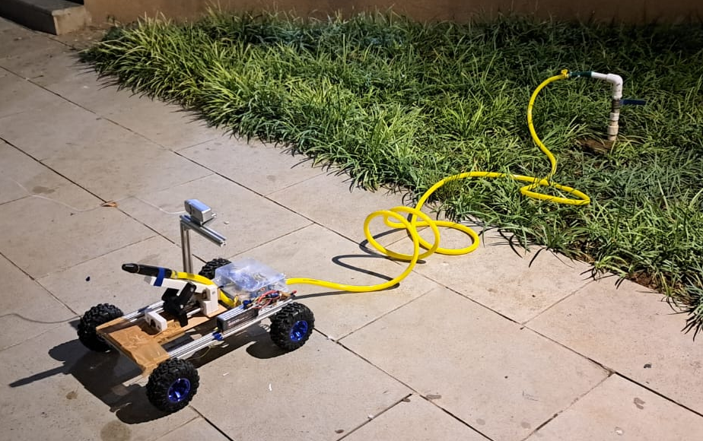
Thank You

